Slide 1
Spatial Clustering and Deconvolution
5/18

Slide 2
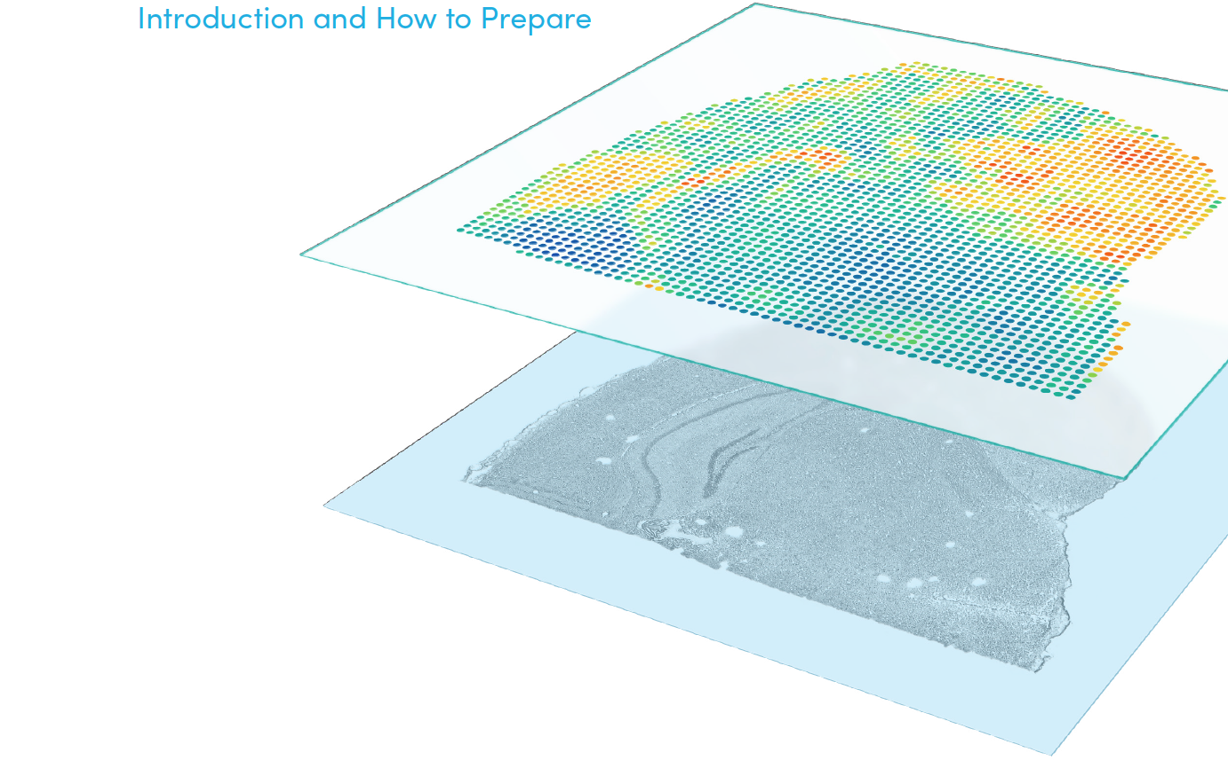
Outline
Visium spatial technology
Spatial clustering
Method
Example: Prefrontal cortex
Spatial deconvolution
Method
Example: Melanoma
Example: Merkel cell carcinoma

Slide 3
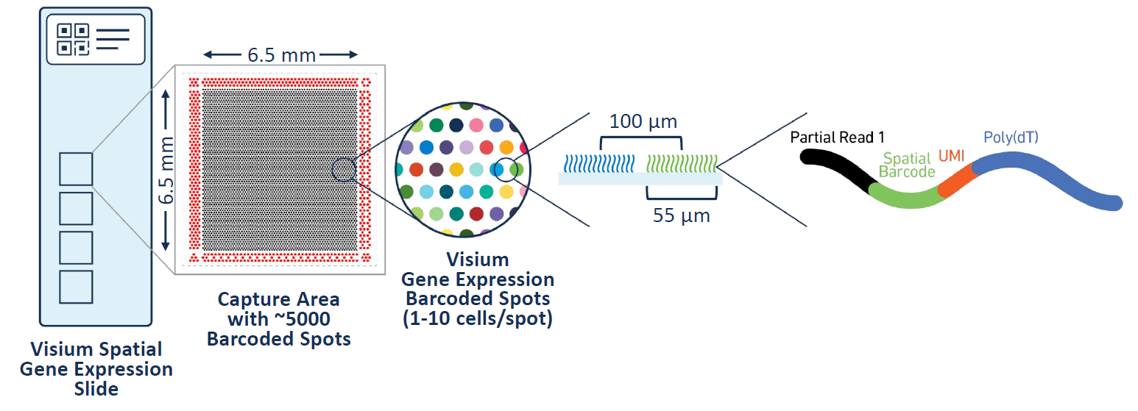
Visium spatial technology
Spatial RNA sequencing provides high-throughput gene expression profiling while preserving the morphological context of the tissue

Slide 4
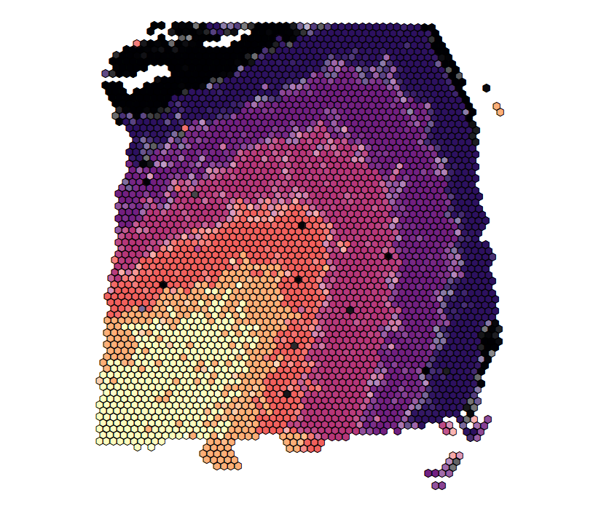
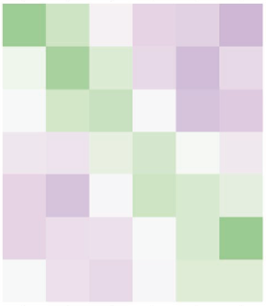
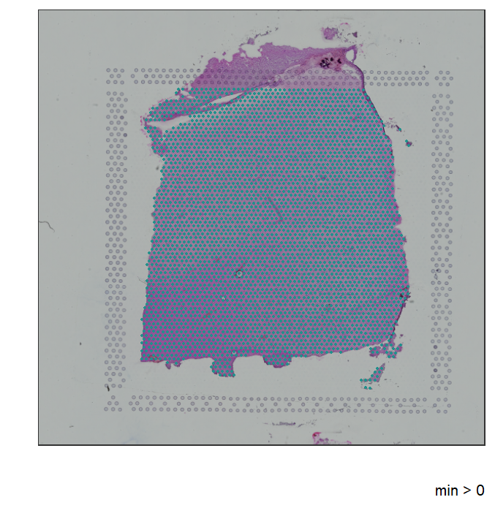
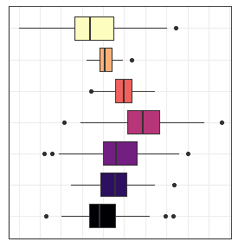
Spatial clustering
Accurate clustering is an important step that allows downstream analyses such as cell type or tissue annotation and differential expression to provide unbiased biological insights
L1
L2
L3
L4
L5
L6
WM

Slide 5
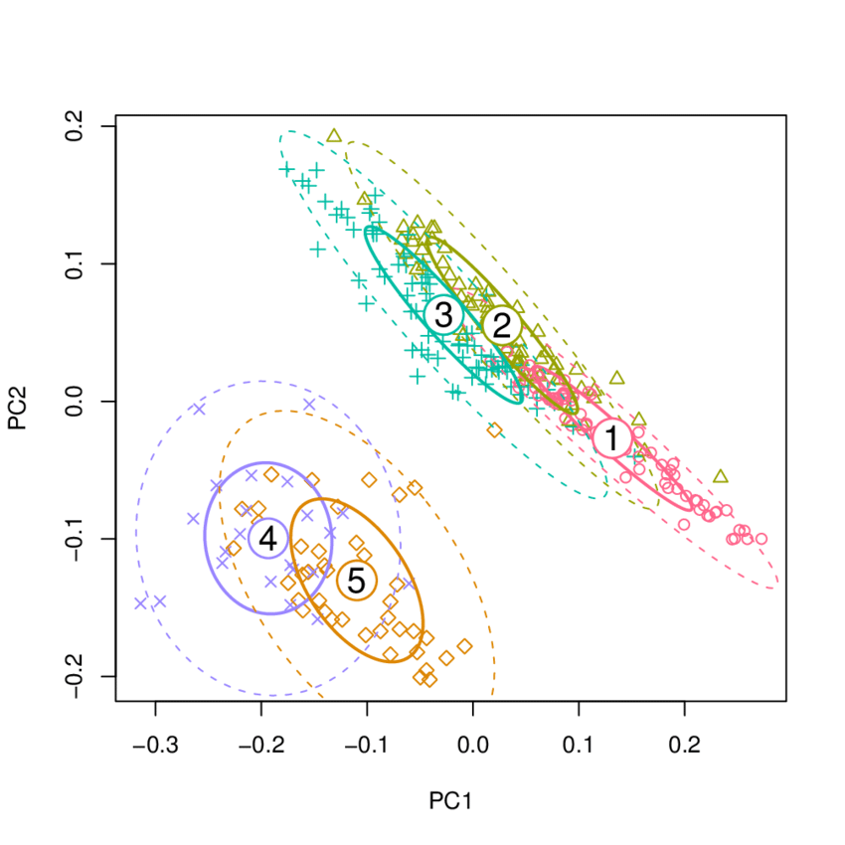
Method
Fit a parametric model to the observed data (principal components)
Using MCMC, iteratively estimate the center of each cluster, variance within clusters, and cluster label of each spot
Spatially smooth cluster labels by encouraging neighboring spots to belong to the same cluster

Slide 6
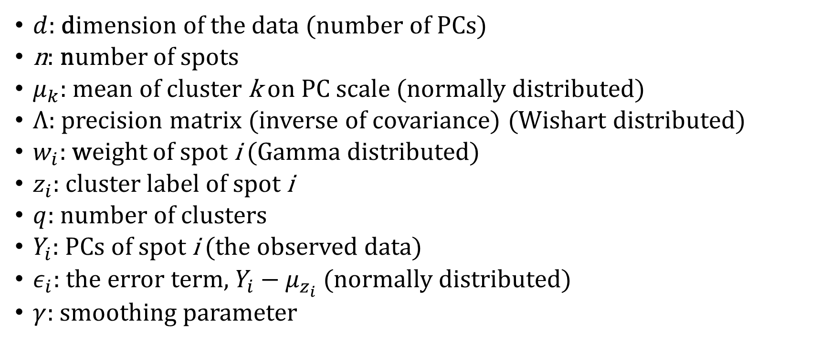
Glossary
$d$: dimension of the data (number of PCs)
n: number of spots
$μ_{k}$: mean of cluster k on PC scale (normally distributed)
$Λ$: precision matrix (inverse of covariance) (Wishart distributed)
$w_{i}$: weight of spot i (Gamma distributed)
$z_{i}$: cluster label of spot i
$q$: number of clusters
$Y_{i}$: PCs of spot i (the observed data)
$ε_{i}$: the error term, $Y_{i}−μ_{z_{i}}$ (normally distributed)
$γ$: smoothing parameter

Slide 7
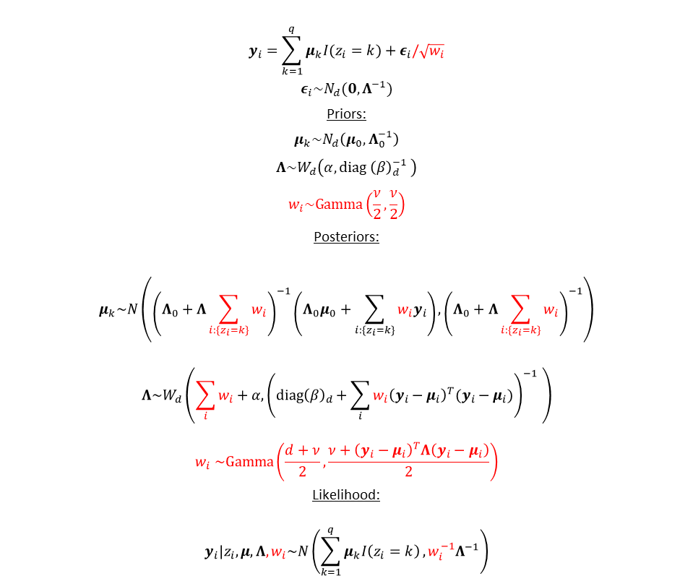
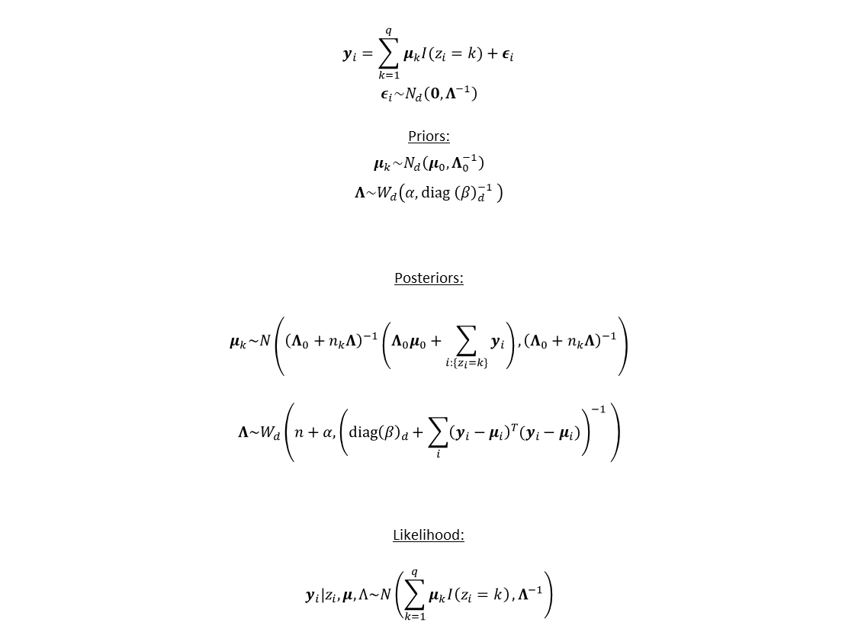
Normal (left) vs. t-distributed (right) likelihood
$$y_{i}=\sum_{k=1}^{q}{μ_{k}I(z_{i}=k)}+ε_{i}$$
$$ε_{i}\sim N_{d}\left(0,Λ^{−1}\right)$$
Priors:
$$μ_{k}\sim N_{d}\left(μ_{0},Λ_{0}^{−1}\right)$$
$$Λ\sim W_{d}\left(α,diag {\left(β\right)}_{d}^{−1} \right)$$
Posteriors:
$$μ_{k}\sim N\left({\left(Λ_{0}+n_{k}Λ\right)}^{−1}\left(Λ_{0}μ_{0}+\sum_{{i:\{z}_{i}=k\}}{y_{i}}\right),{\left(Λ_{0}+n_{k}Λ\right)}^{−1}\right)$$
$$Λ\sim W_{d}\left(n+α,{\left(diag{\left(β\right)}_{d}+\sum_{i}{{\left(y_{i}−μ_{i}\right)}^{T}(y_{i}−μ_{i})}\right)}^{−1} \right)$$
Likelihood:
$$y_{i}|z_{i},μ,Λ\sim N\left(\sum_{k=1}^{q}{μ_{k}I\left(z_{i}=k\right)},Λ^{−1}\right)$$
$$y_{i}=\sum_{k=1}^{q}{μ_{k}I(z_{i}=k)}+ε_{i}/\sqrt{w_{i}}$$
$$ε_{i}\sim N_{d}(0,Λ^{−1})$$
Priors:
$$μ_{k}\sim N_{d}\left(μ_{0},Λ_{0}^{−1}\right)$$
$$Λ\sim W_{d}\left(α,diag {\left(β\right)}_{d}^{−1} \right)$$
$$w_{i}\sim Gamma\left(\frac{ν}{2},\frac{ν}{2}\right)$$
Posteriors:
$$μ_{k}\sim N\left({\left(Λ_{0}+Λ\sum_{i:\{z_{i}=k\}}{w_{i}}\right)}^{−1}\left(Λ_{0}μ_{0}+\sum_{{i:\{z}_{i}=k\}}{{w_{i}y}_{i}}\right),{\left(Λ_{0}+Λ\sum_{i:\{z_{i}=k\}}{w_{i}}\right)}^{−1}\right)$$
$$Λ\sim W_{d}\left(\sum_{i}{w_{i}}+α,{\left(diag{\left(β\right)}_{d}+\sum_{i}{{w_{i}\left(y_{i}−μ_{i}\right)}^{T}(y_{i}−μ_{i})}\right)}^{−1} \right)$$
$$w_{i} \sim Gamma\left(\frac{d+ν}{2},\frac{ν+{\left(y_{i}−μ_{i}\right)}^{T}Λ\left(y_{i}−μ_{i}\right)}{2}\right)$$
Likelihood:
$$y_{i}|z_{i},μ,Λ,w_{i}\sim N\left(\sum_{k=1}^{q}{μ_{k}I\left(z_{i}=k\right)},{w_{i}^{−1}Λ}^{−1}\right)$$
Parametric form of the data
Distribution of errors
Priors and posteriors of
Mean, precision, weights
Conditional likelihood of data
given estimated parameters

Slide 8
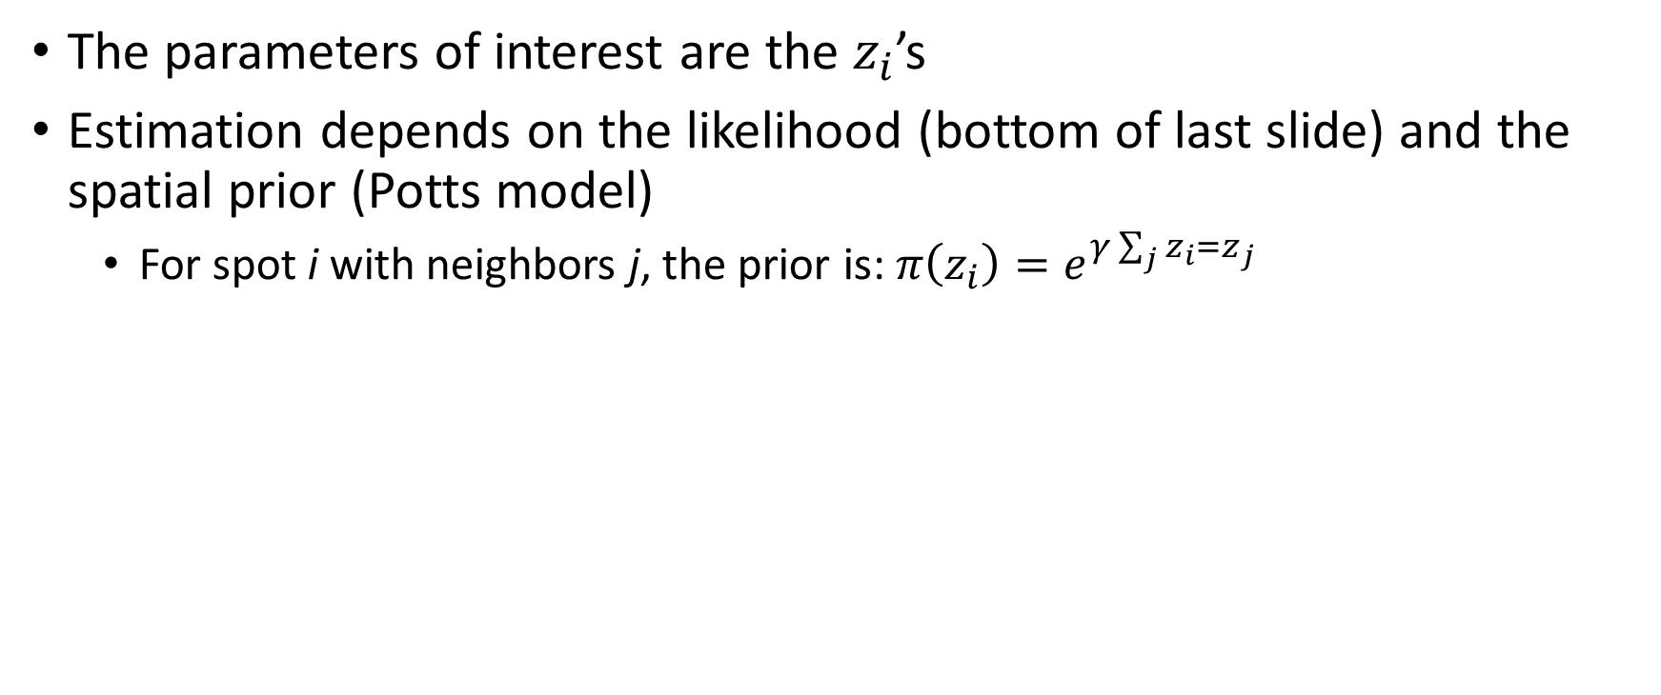
Prior
The parameters of interest are the $z_{i}$’s
Estimation depends on the likelihood (bottom of last slide) and the spatial prior (Potts model)
For spot i with neighbors j, the prior is: ${π\left(z_{i}\right)=e}^{γ\sum_{j}{z_{i}=z_{j}}}$

Slide 9
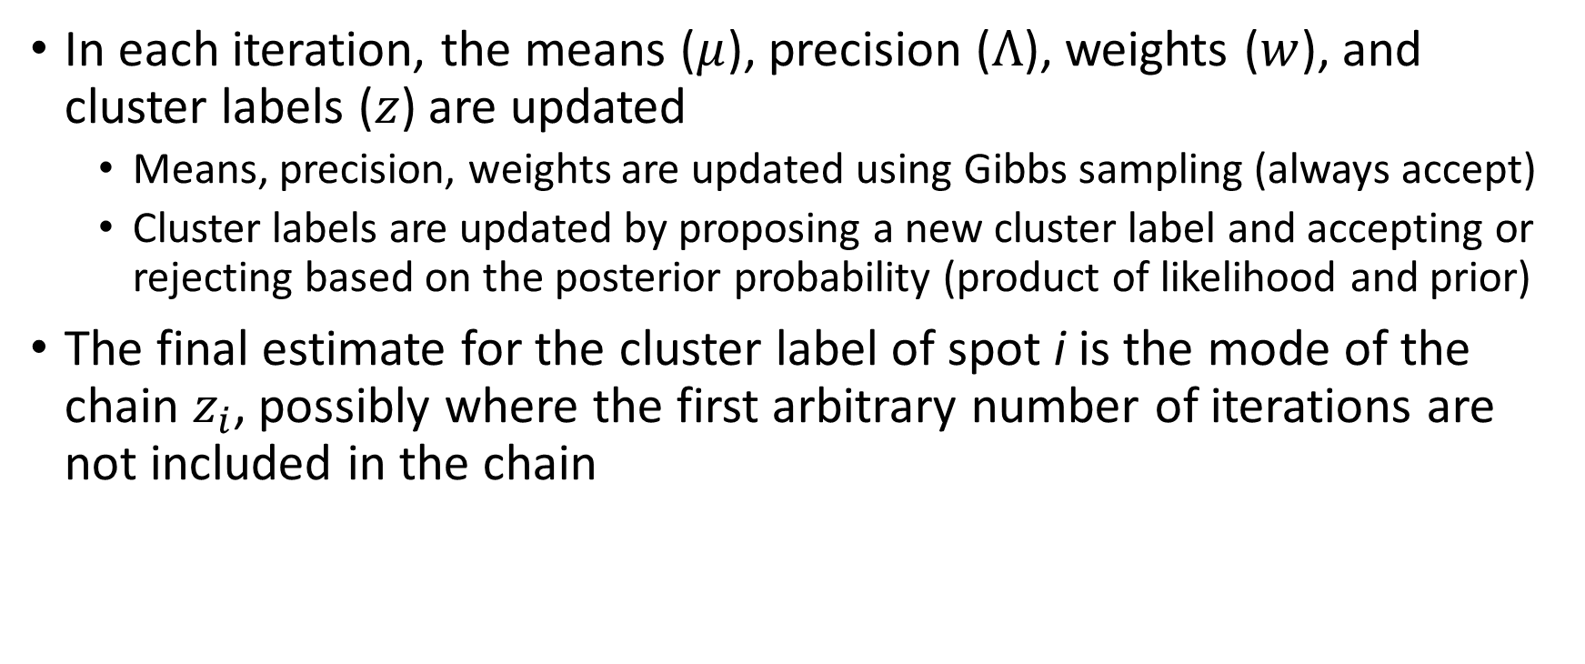
Estimation
In each iteration, the means ($μ$), precision ($Λ$), weights ($w$), and cluster labels ($z$) are updated
Means, precision, weights are updated using Gibbs sampling (always accept)
Cluster labels are updated by proposing a new cluster label and accepting or rejecting based on the posterior probability (product of likelihood and prior)
The final estimate for the cluster label of spot i is the mode of the chain $z_{i}$, possibly where the first arbitrary number of iterations are not included in the chain

Slide 10
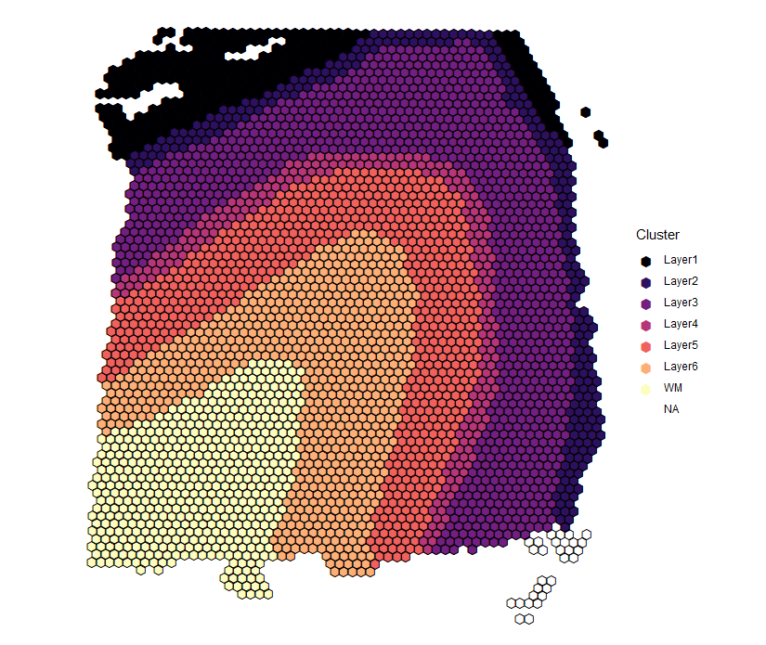
Dorsolateral prefrontal cortex (Maynard et al., 2020)
Manual annotation by expert based on cytoarchitecture and selected marker genes
Considered ground truth
Labor-intensive

Slide 11
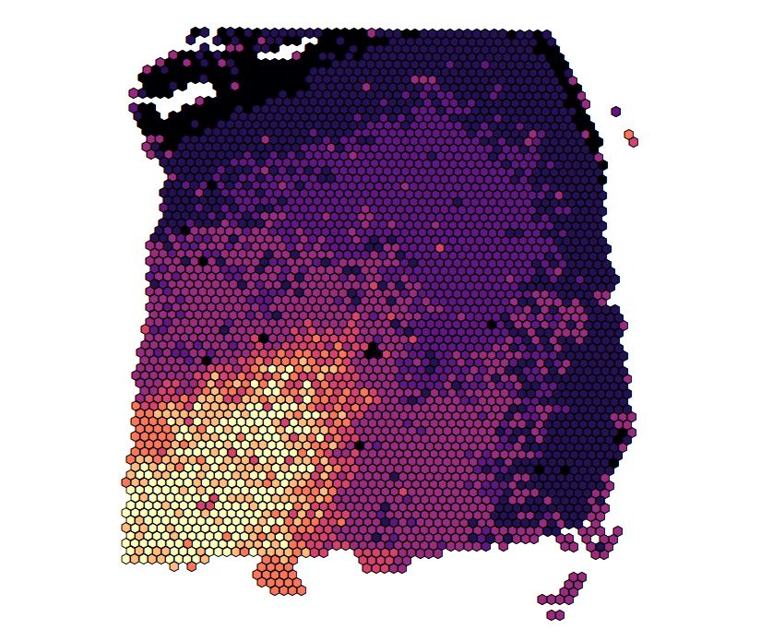
Non-spatial clustering
Shared nearest neighbor clustering on top 50 principal components (PCs) generated from highly variable genes (HVGs) + spatial coordinates
Set to return 8 clusters to improve clustering performance
Adjusted Rand Index (ARI) = 0.27

Slide 12
Spatial clustering
Spatial clustering on top 9 principal components (PCs) generated from highly variable genes (HVGs)
Set to return 7 clusters to match prior knowledge of prefrontal cortex cytoarchitecture
ARI = 0.47

Slide 13
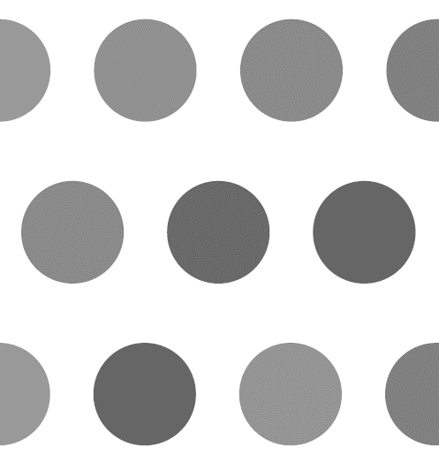
Spatial deconvolution
Visium is not a single cell technology
Deconvolution can:
Increase the resolution of the spatial map
Allow for better understanding of tissues composed of heterogenous mixtures of cells (e.g. tumor microenvironment)

Slide 14
Method
Similar to clustering method, except now the unit of analysis is not a spot but instead a “cell”
Using MCMC, iteratively estimate the center of each cluster, variance within clusters, and cluster label of each “cell” while accounting for the spatial structure
In each iteration, jitter the features of each “cell” while keeping the sum over all “cells” within a spot fixed

Slide 15
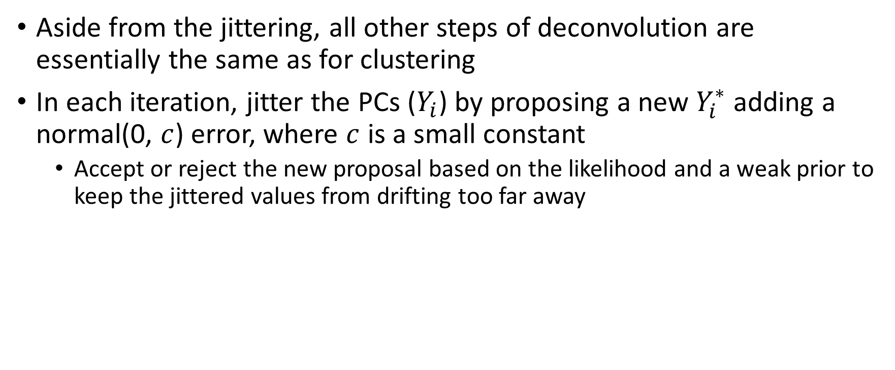
Jittering
Aside from the jittering, all other steps of deconvolution are essentially the same as for clustering
In each iteration, jitter the PCs ($Y_{i}$) by proposing a new $Y_{i}^{∗}$ adding a normal(0, $c$) error, where $c$ is a small constant
Accept or reject the new proposal based on the likelihood and a weak prior to keep the jittered values from drifting too far away

Slide 16
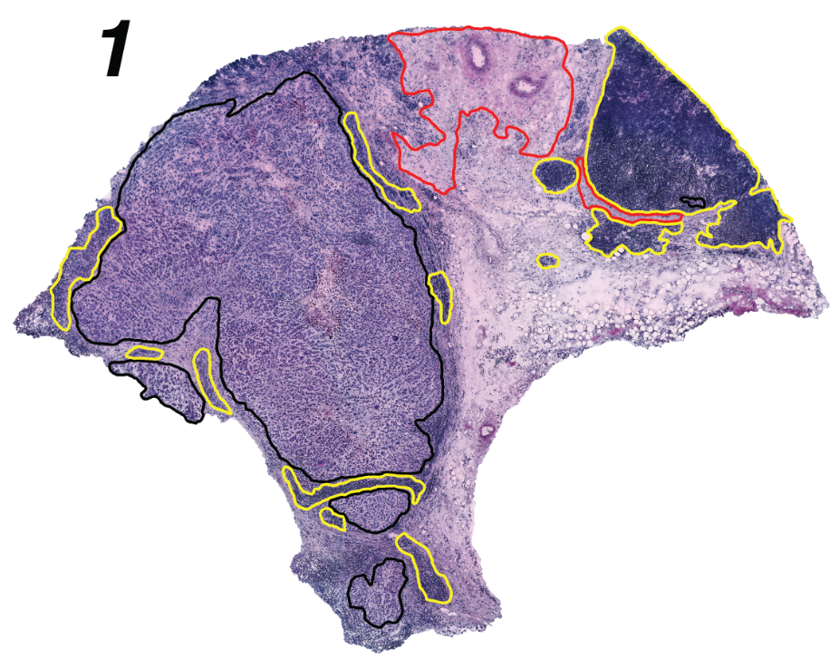
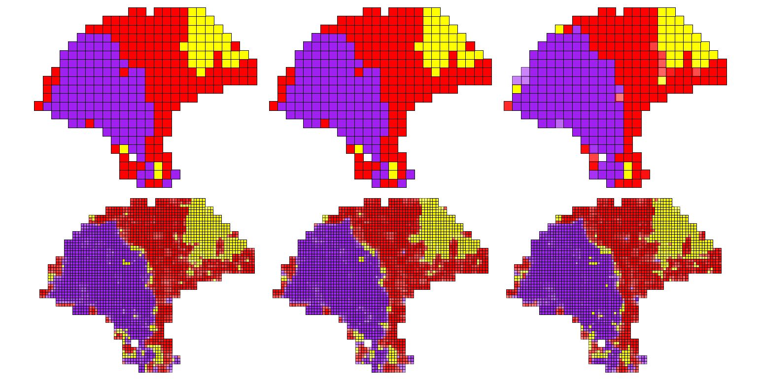
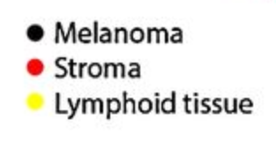
Melanoma (Thrane et al., 2018)

Slide 17
Deconvolution reveals heterogeneity in the tumor immune microenvironment

Slide 18
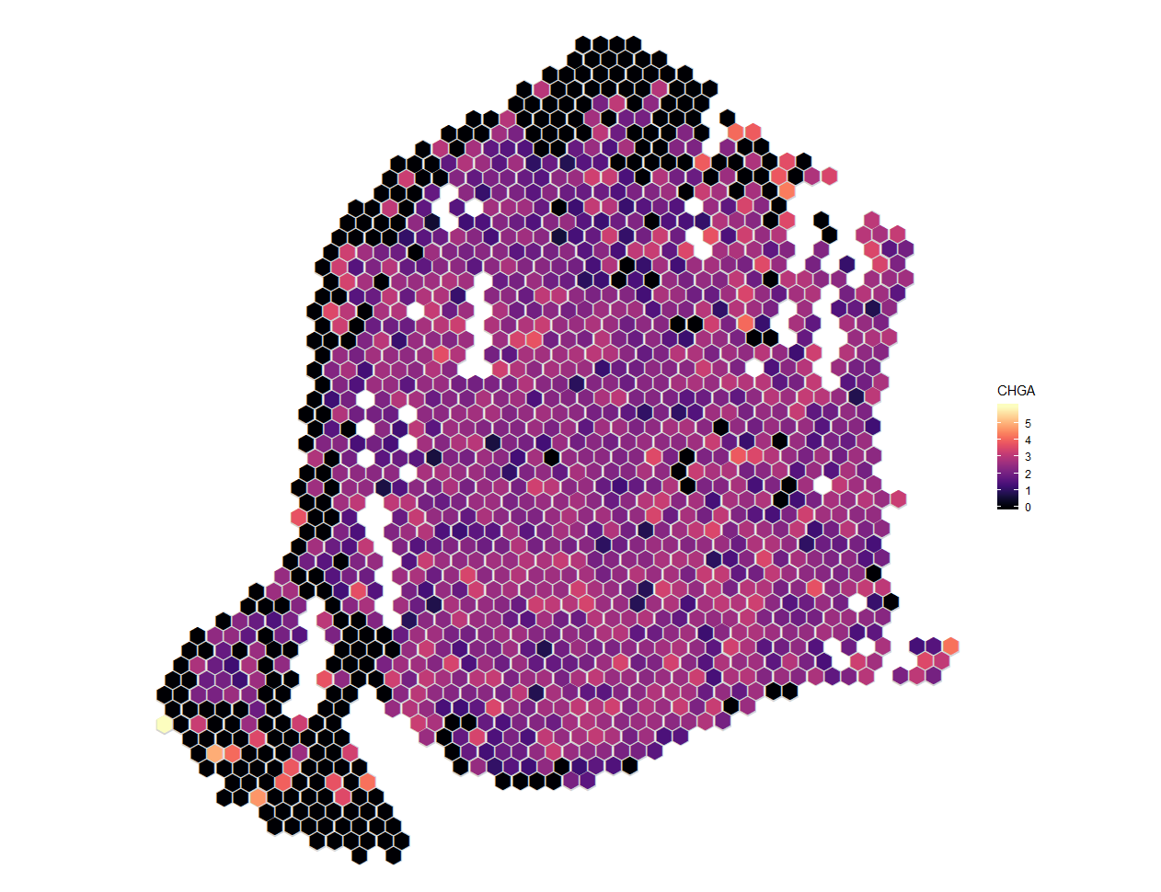
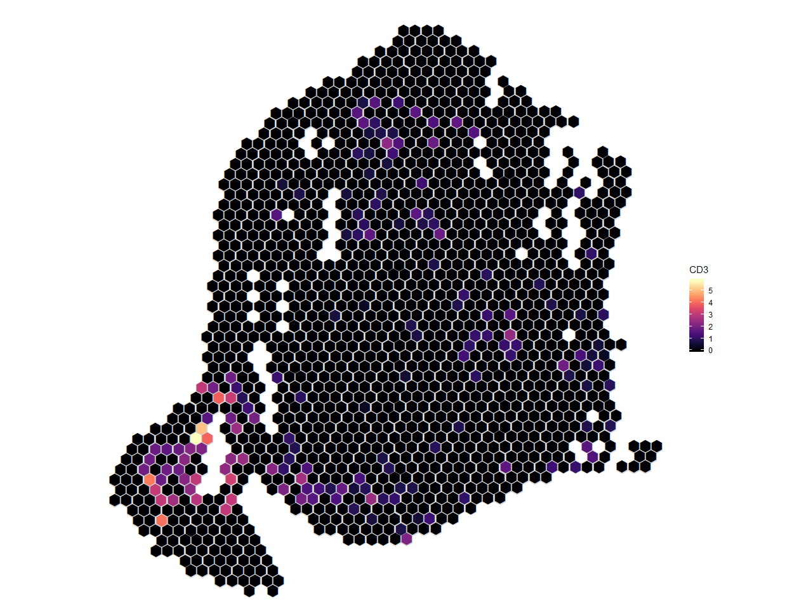
Merkle cell carcinoma (MCC)
CHGA (cancer marker) expression
CD3 (T cell marker) expression

Slide 19
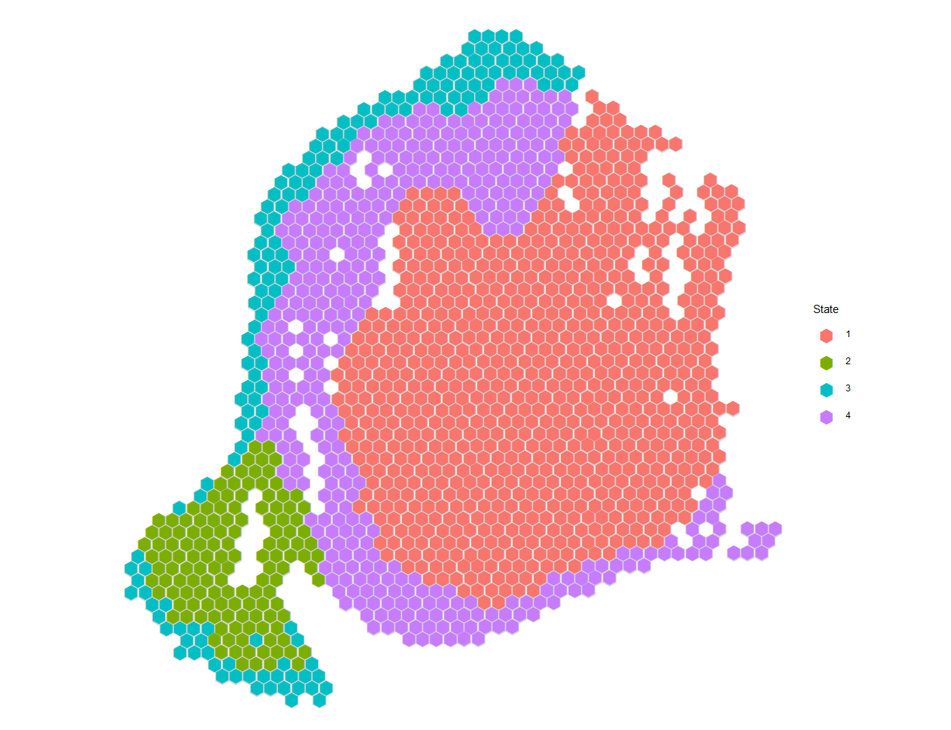
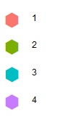
Spatial clustering
Clusters 1 and 4 from spatial clustering correspond to the tumor
Cluster 2 has the highest immune expression

Slide 20
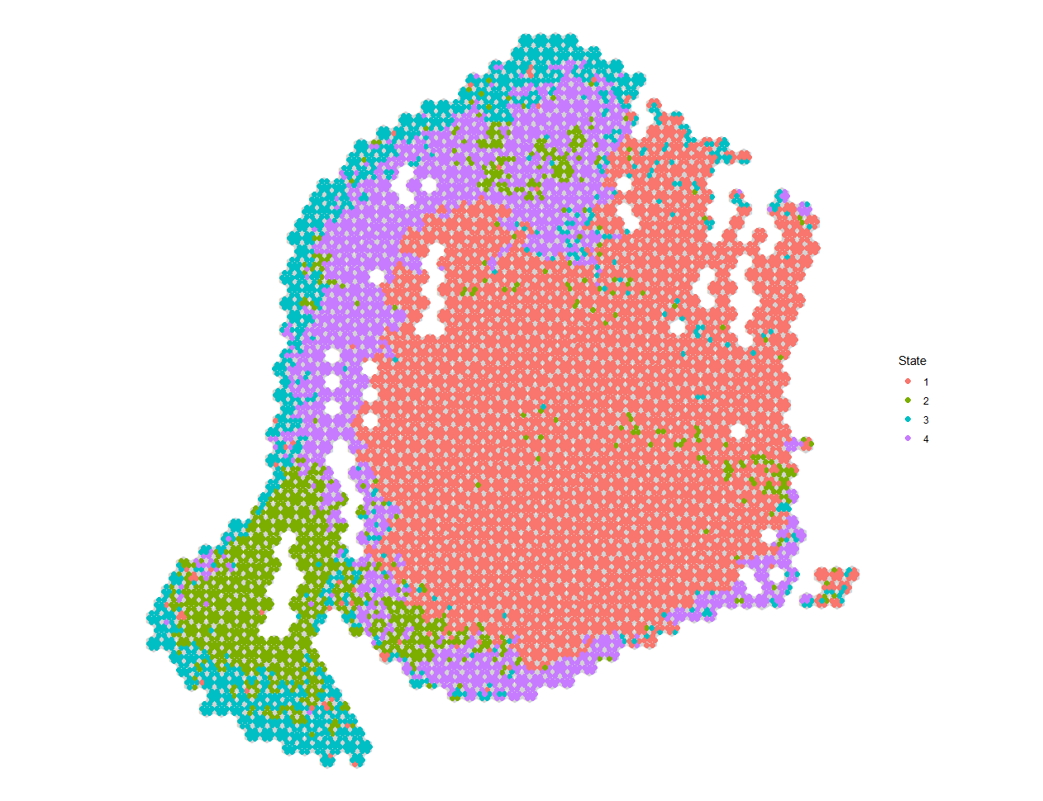
Spatial deconvolution
Most of the immune cells (green) are at the periphery of the tumor
However, there is some evidence of immune infiltration inside the tumor

